Slide 1
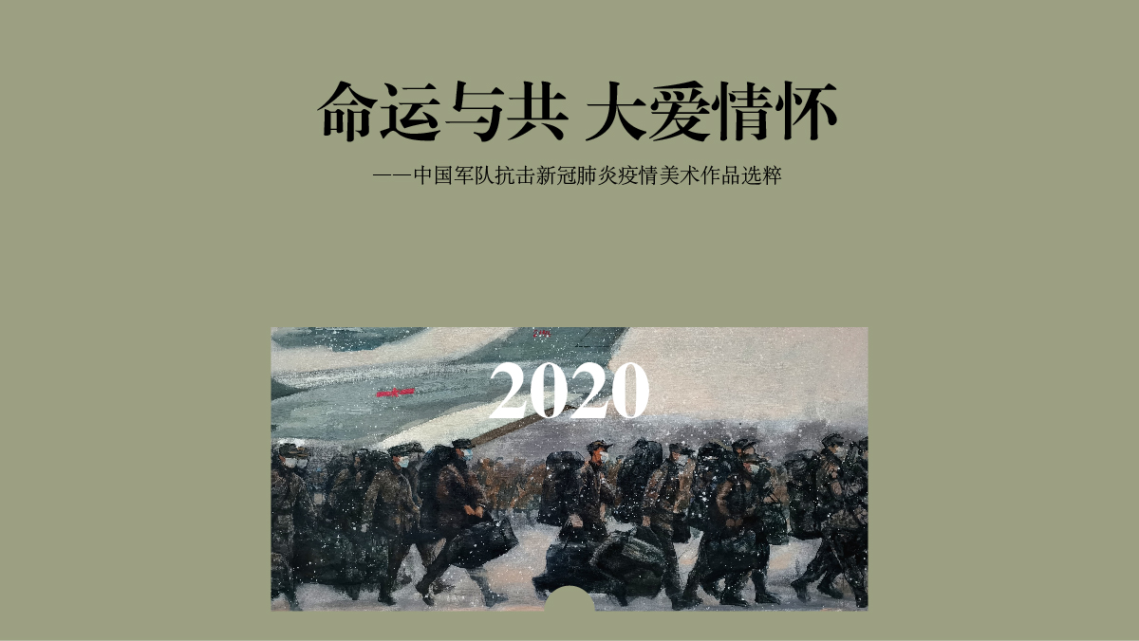
Shared Destiny Boundless Love
—— Selected Art Works on Chinese Soldiers’ Fight against COVID-19

Slide 2
Shared Destiny Boundless Love
Since the outbreak of the COVID-19 epidemic, Chinese armed forces rushed to the frontline without hesitation with all-out efforts to save lives and safeguard people’s safety and health. They wrote a moving story against the epidemic with love, sweat and sacrifice. As a reliable force to protect people’s lives and safeguard peace, the Chinese military and the Chinese people breathe the same air, share the same fate and are closely connected.
Knowing no borders, viruses are the common enemy of all human beings, to which no country can stay immune. Thus countries should help one another tide over difficulties. The selected art works feature the Chinese soldiers fighting bravely on the frontline, who helped dispel the gloom of the epidemic with warm sunshine, defeat the virus through solidarity and guard global health security.
—— Selected Art Works on Chinese Soldiers’ Fight against COVID-19

Slide 3
Heroes In Harm's Way

Slide 4
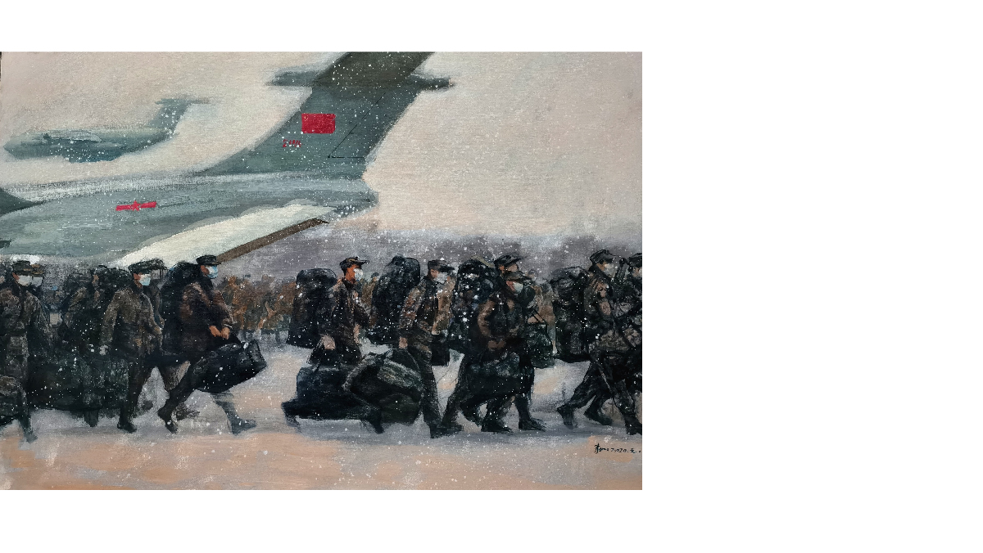
Emergency Rescue in 2020 -- Li Ru

Slide 5
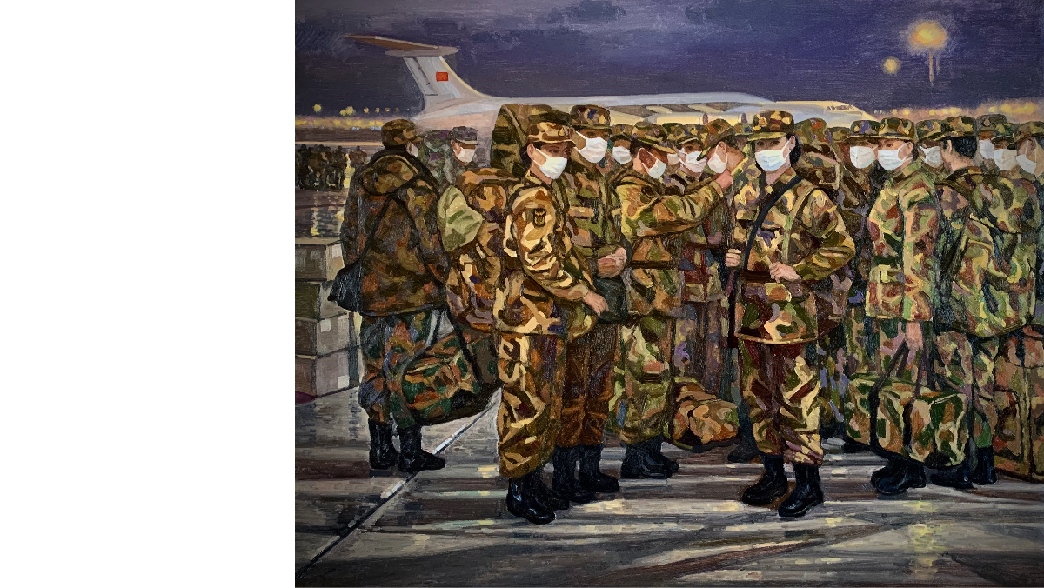
Going For A Battle in 2020 -- Sun Lixin

Slide 6
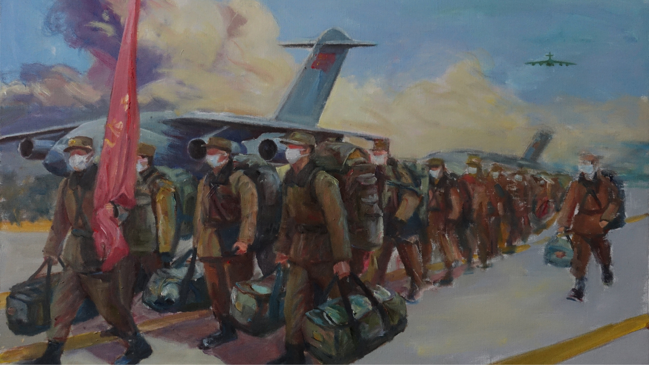
The People’s Liberation Army is Coming -- Deng Yi

Slide 7
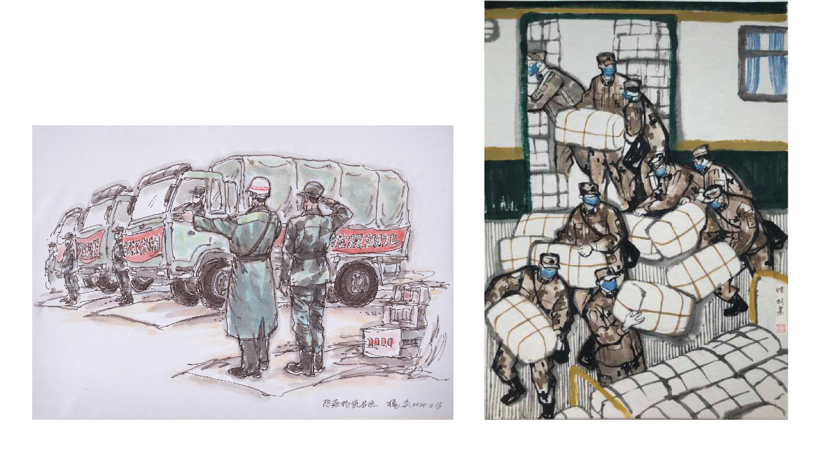
Epidemic Prevention Supplies Hit the Road-- Yang Yi
Emergency Transfer-- Zhang Kaitong

Slide 8
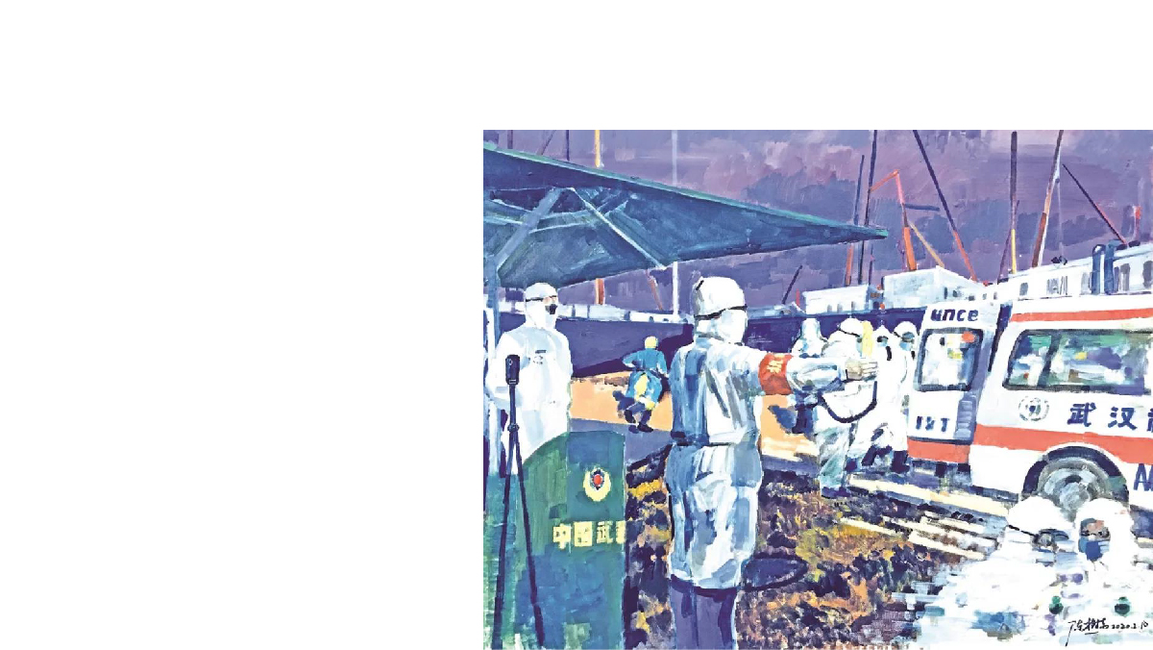
Safeguarding -- Chen Shudong

Slide 9
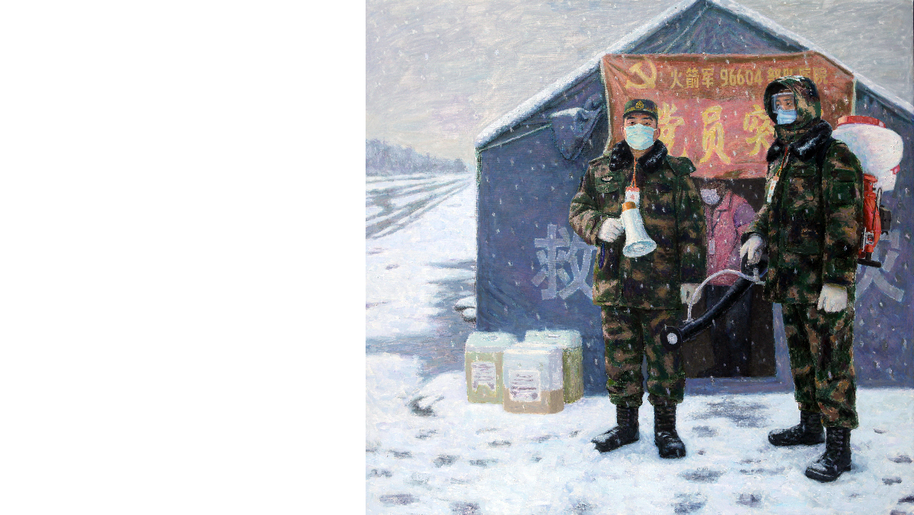
Hot Blood in Freezing Snow -- Dou Hong

Slide 10
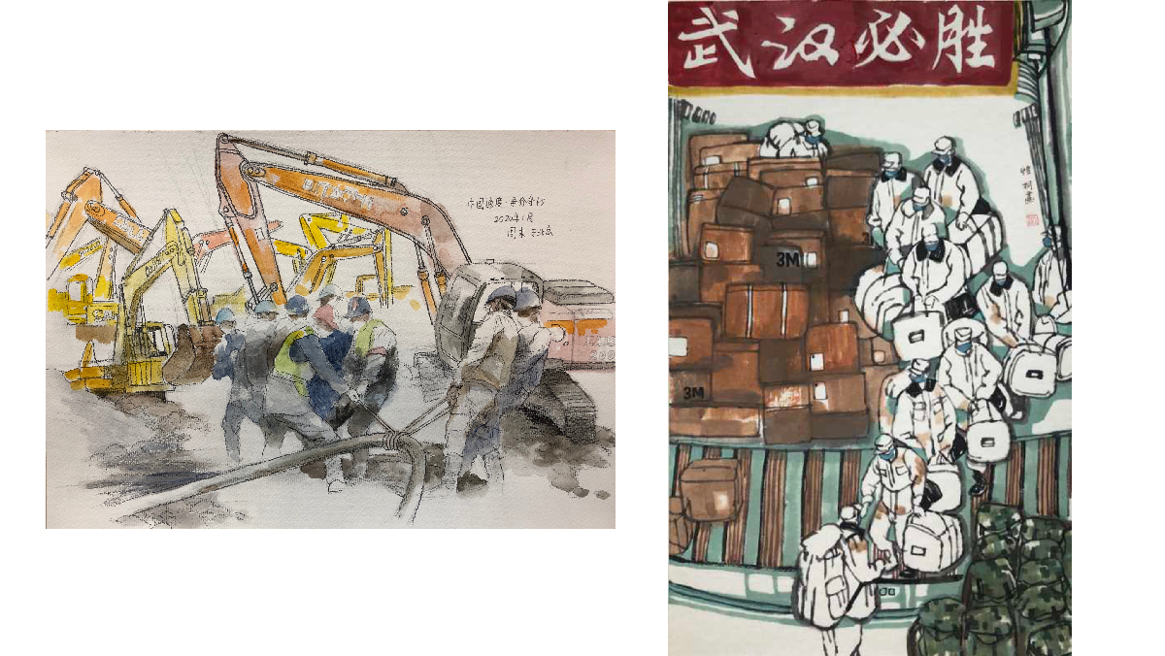
Wuhan Shall Win -- Yang Yi
Chinese Speed ·Every Minute Counts-- Zhou Mo

Slide 11
Treatment with Love

Slide 12
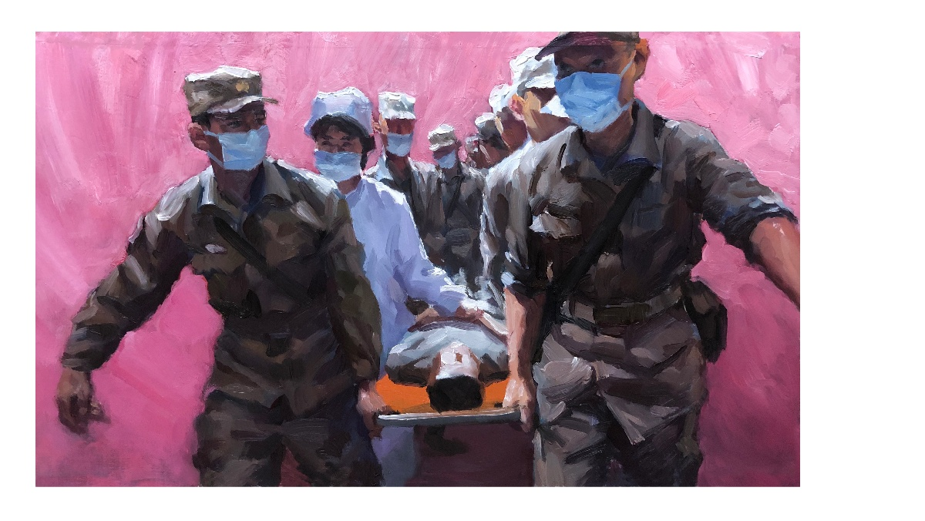
Split Second -- Wang Shupeng

Slide 13
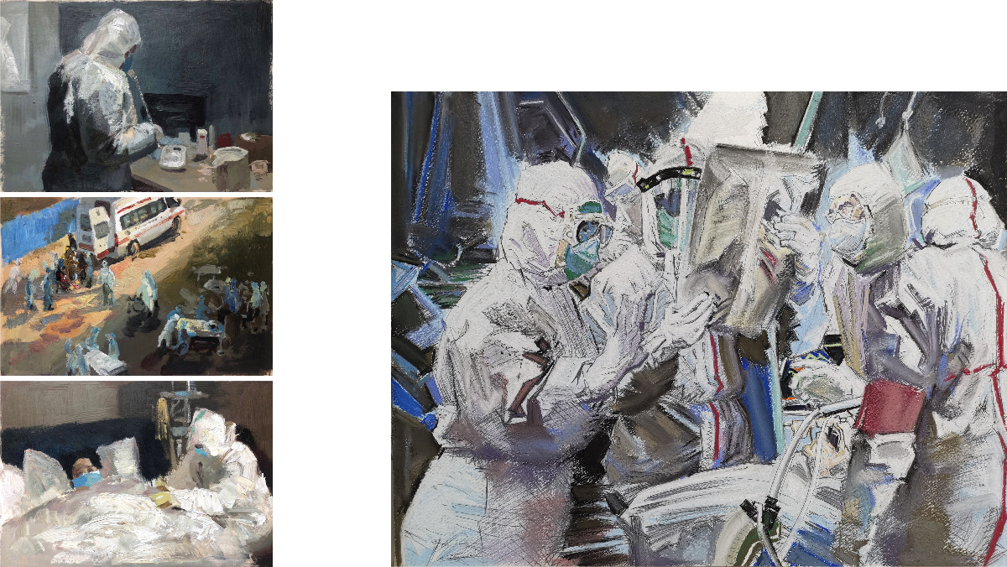
The Moment of Rescue -- Luo Genxing
Fighters -- Hou Tianbai

Slide 14
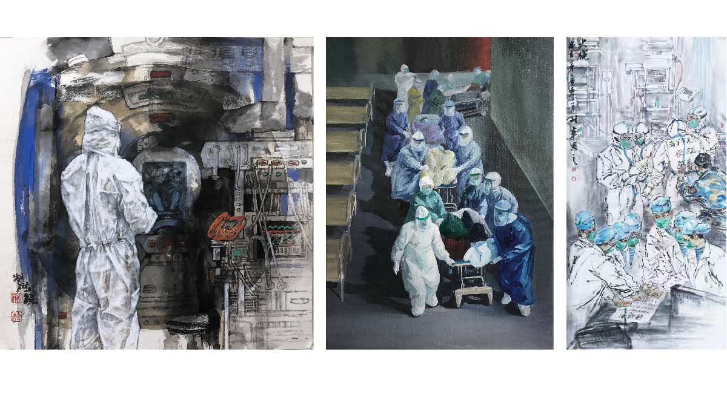
Path of Life -- Zou Liying
Safeguarding Lives -- Fang Quan
Frontline -- Wang lijun

Slide 15
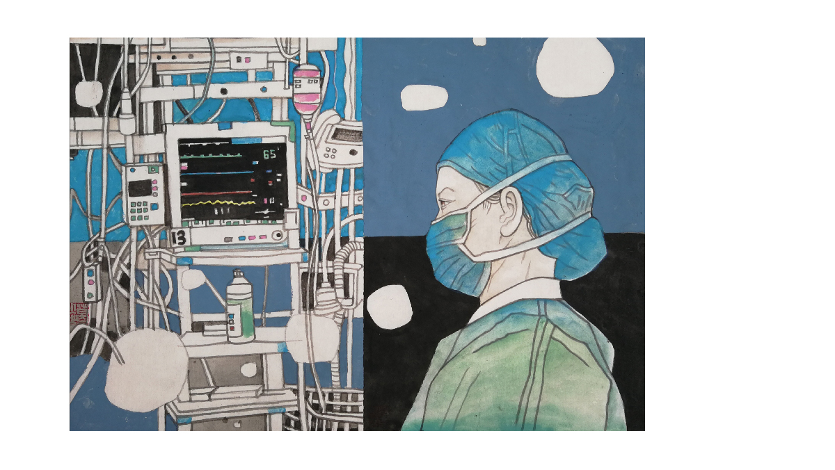
Day and Night -- Ge Yan

Slide 16
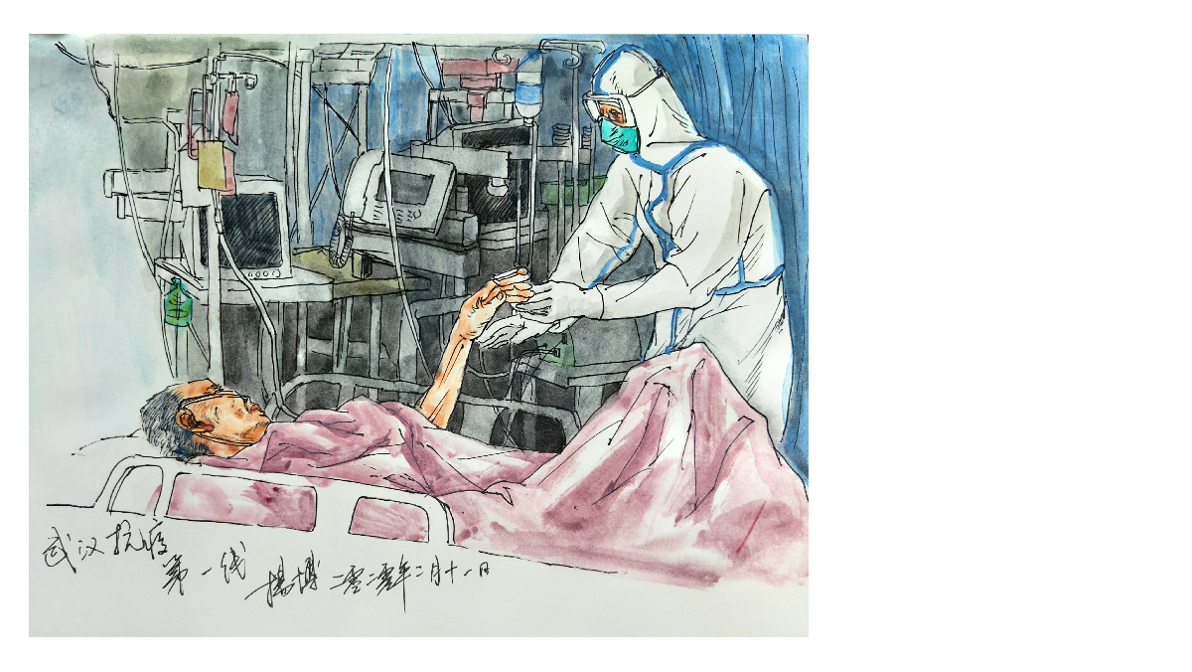
Saving Life Fearlessly -- Yang Bo

Slide 17
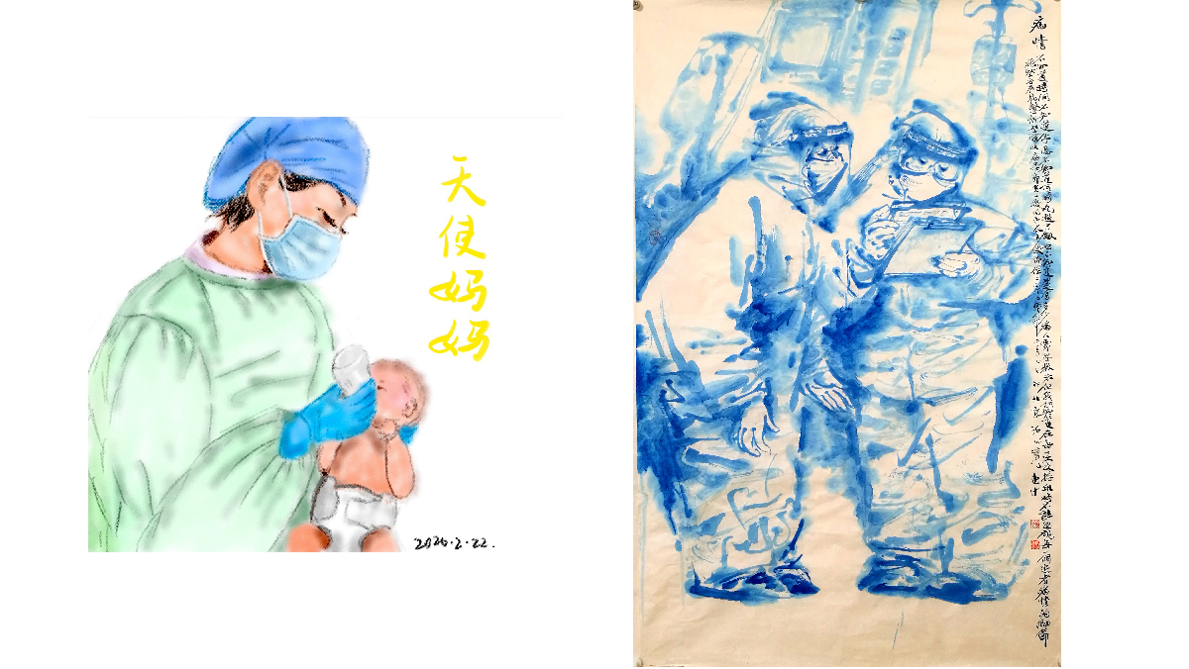
Absorbed In Work -- Ren Huizhong
Angel Mommy -- Wang Dongping

Slide 18
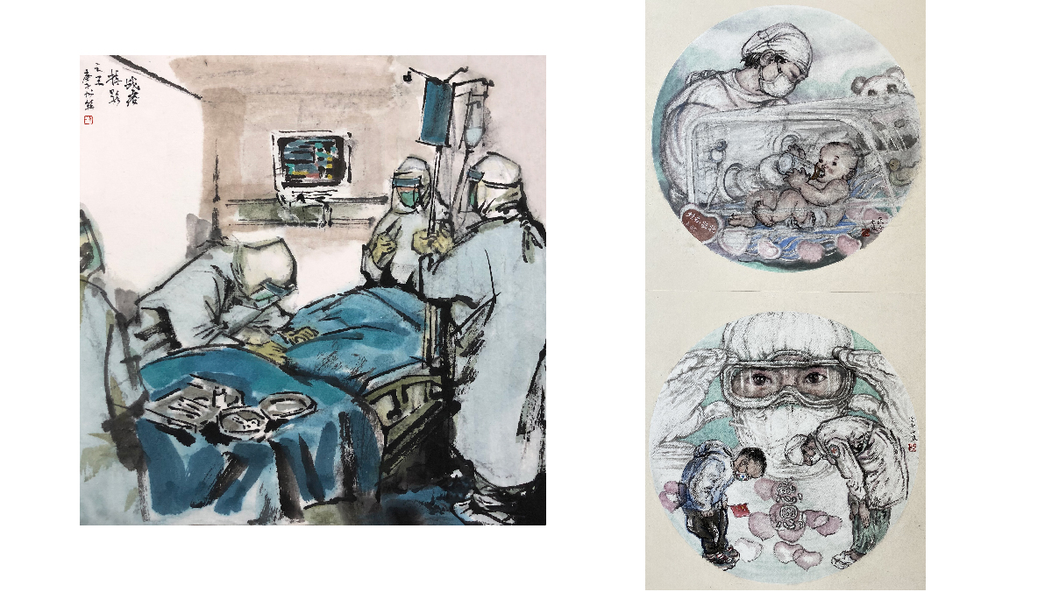
“Thank You” -- Lu Qianbo
A Glimpse of Fight Against Virus -- Liu Shuyi

Slide 19
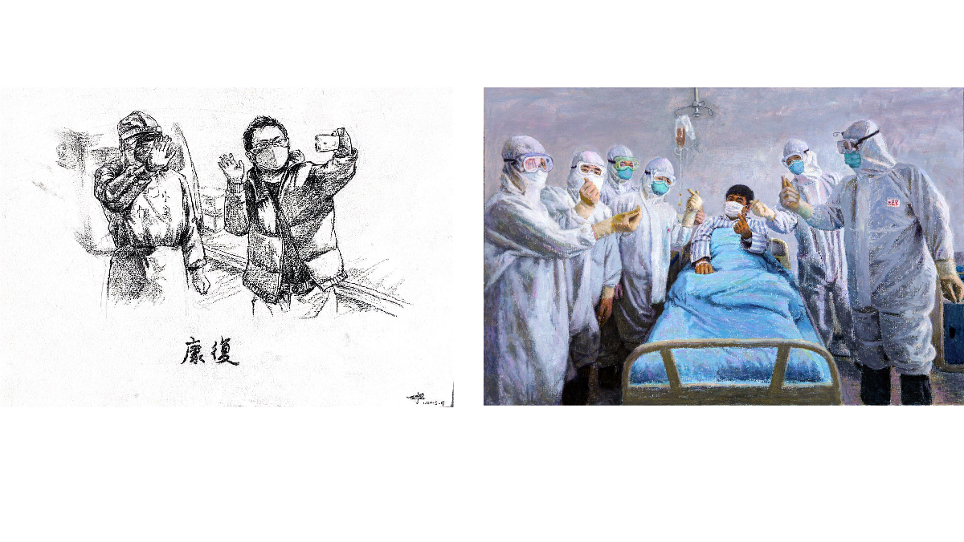
Recovery -- Hu Zhe
Love Never Ends -- Dou Hong

Slide 20
Real Heroes

Slide 21
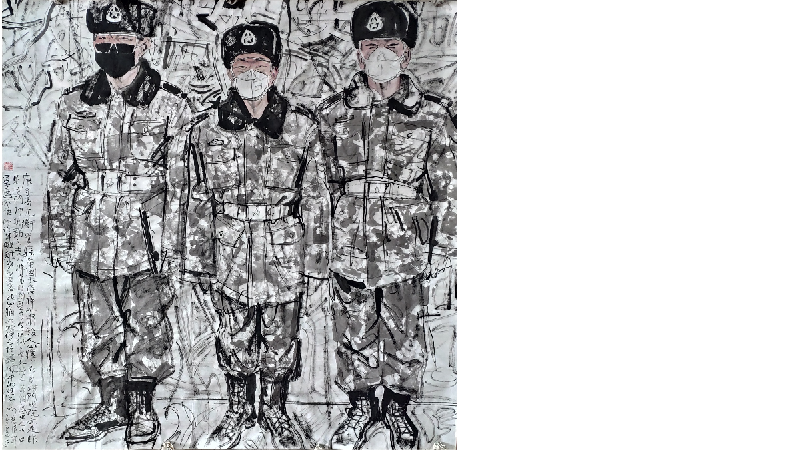
Vanguard -- Sun Hao

Slide 22
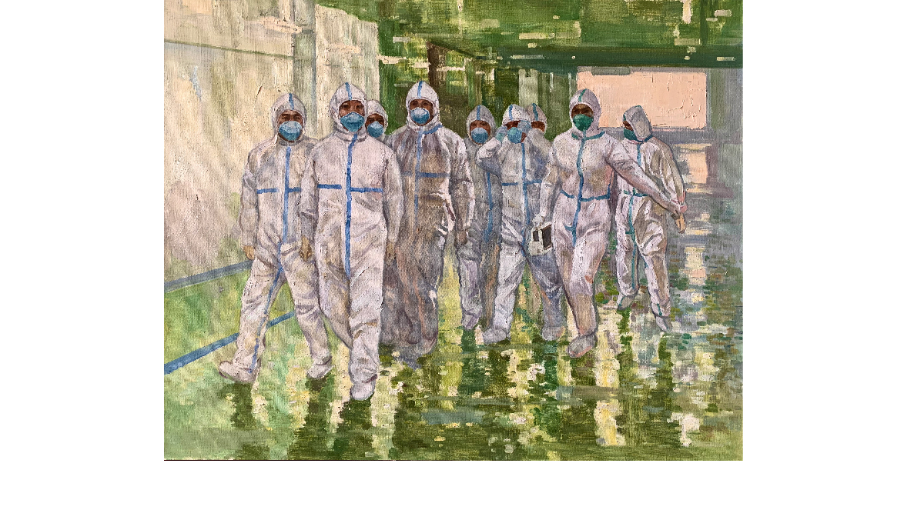
Angels In White To Defend Our Nation -- Sun Lixin

Slide 23
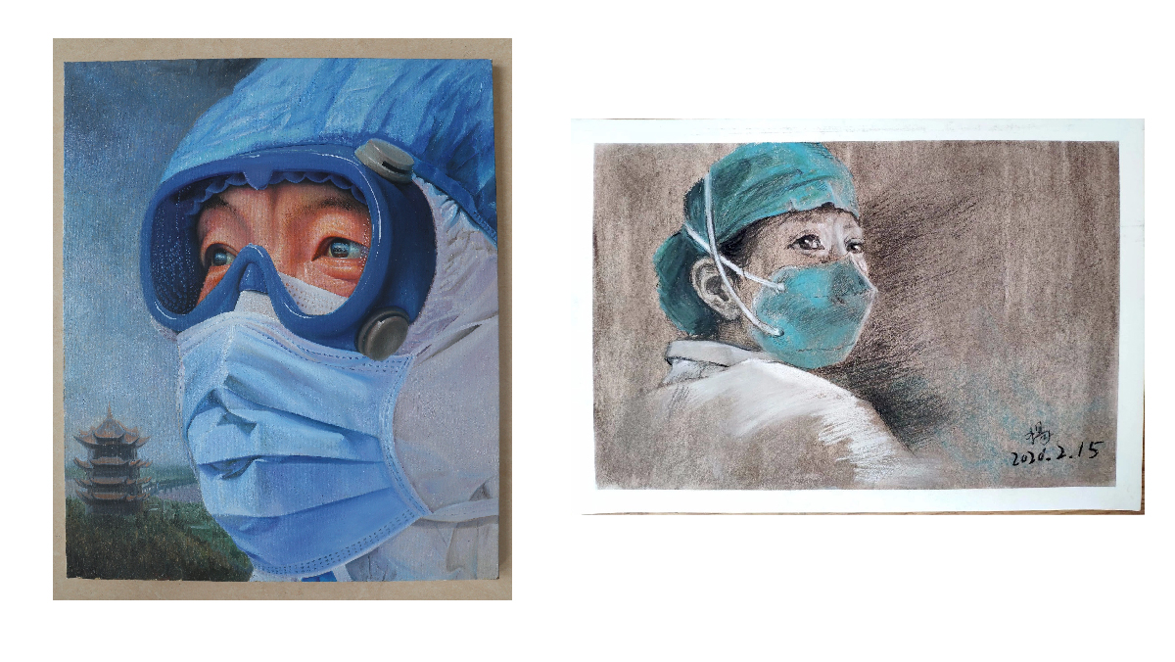
Gaze -- Yang Ningning
Chasing Time -- Dang Feng

Slide 24
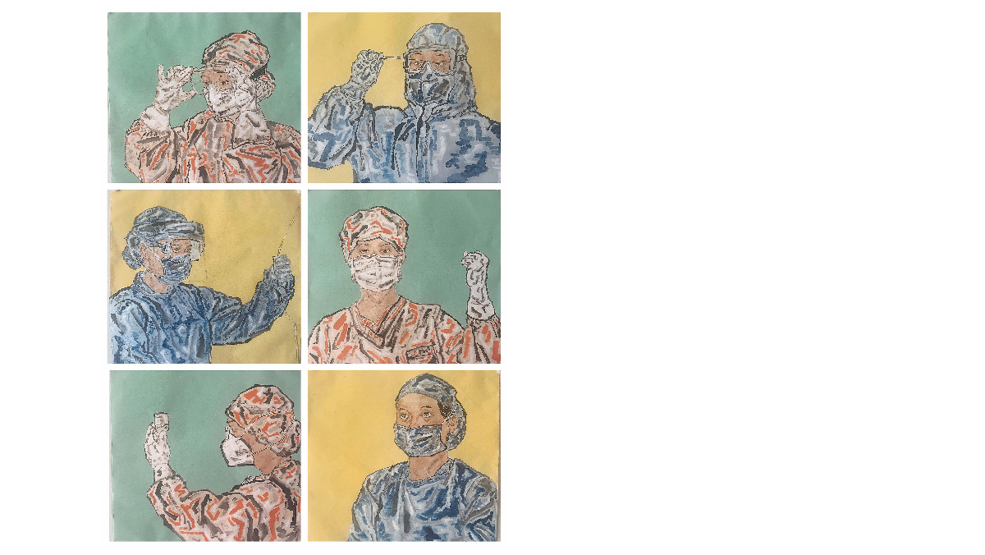
Angels' Eyes -- Zhao Shuaiqi

Slide 25
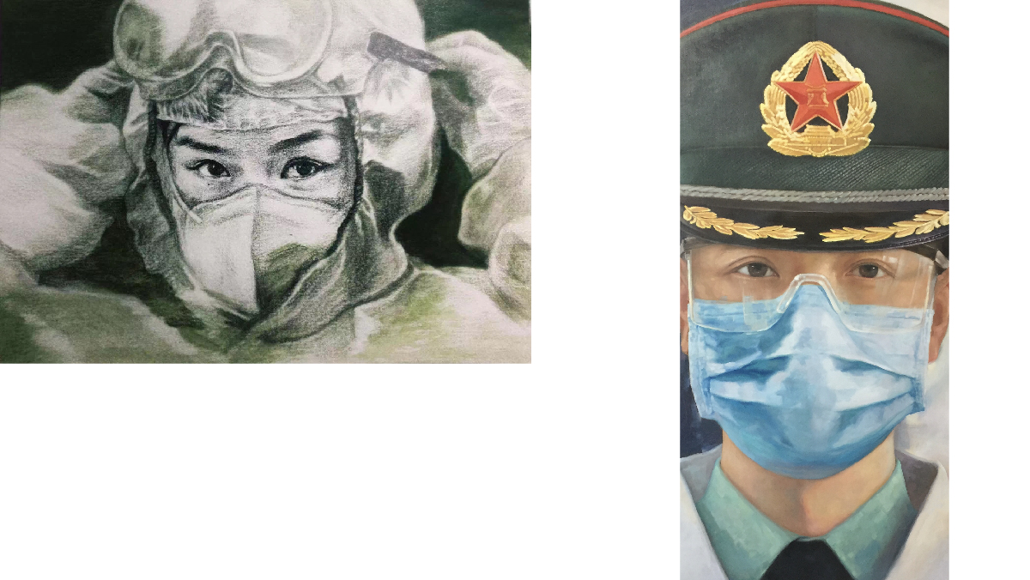
I'll Do It -- Hu Xing, Su Nan
Military Medic -- Zhou Fulin

Slide 26
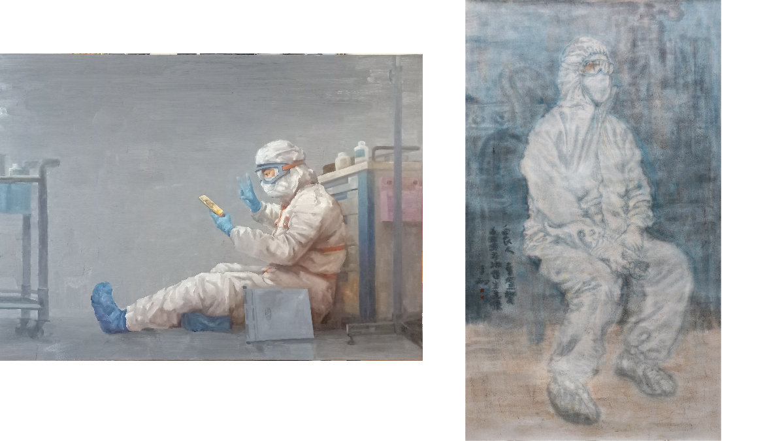
Before Dawn -- Li Xiang
Midnight -- Li Yuejin

Slide 27
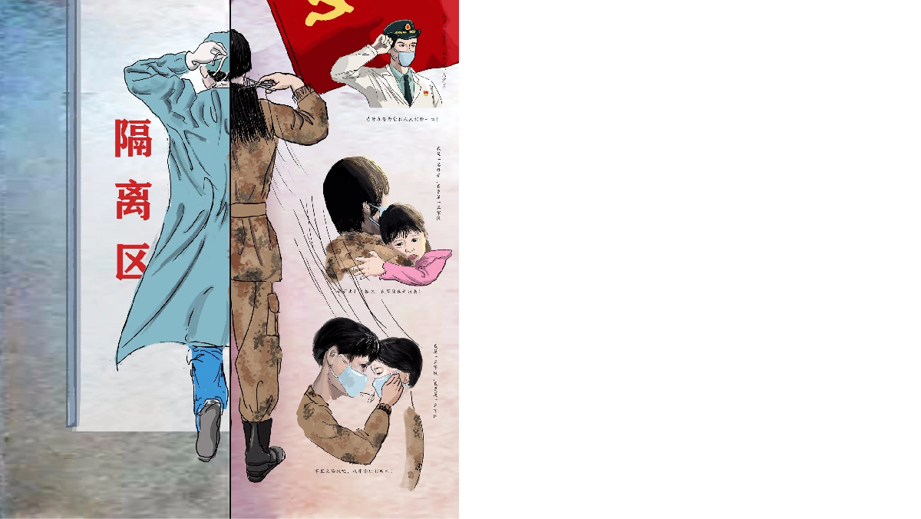
My Roles -- Ren Ran

Slide 28
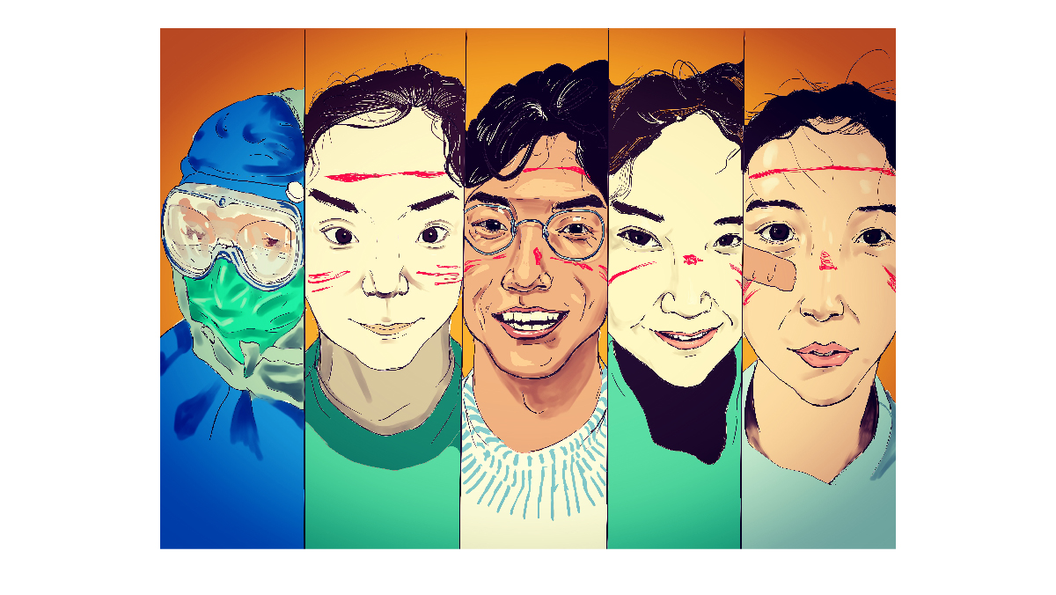
Angels' Faces -- Song Haowen

Slide 29
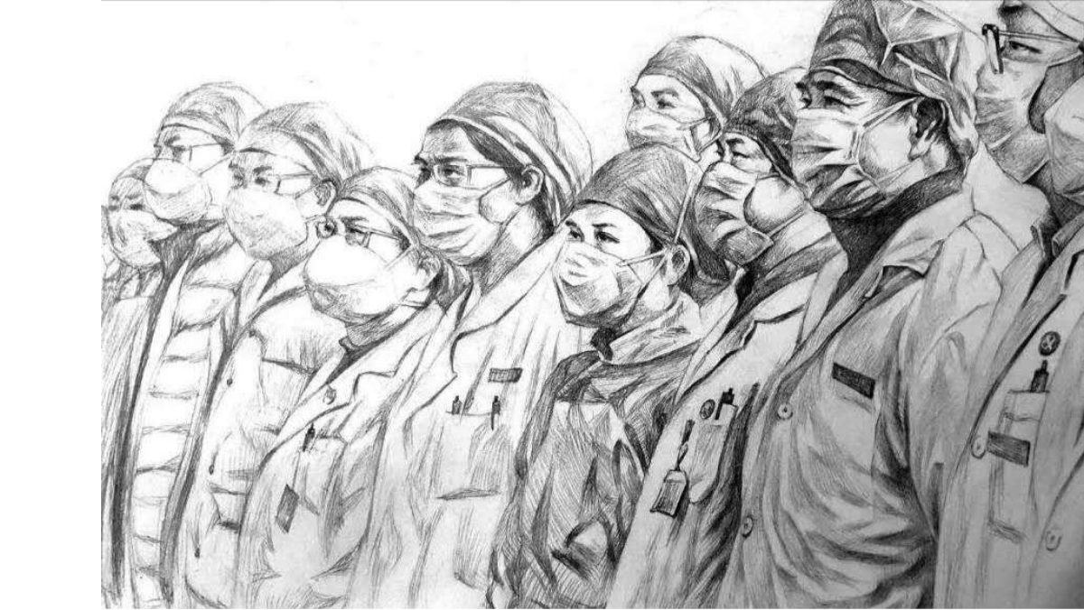
Great Wall Of Angels In White -- Xue Feng

Slide 30
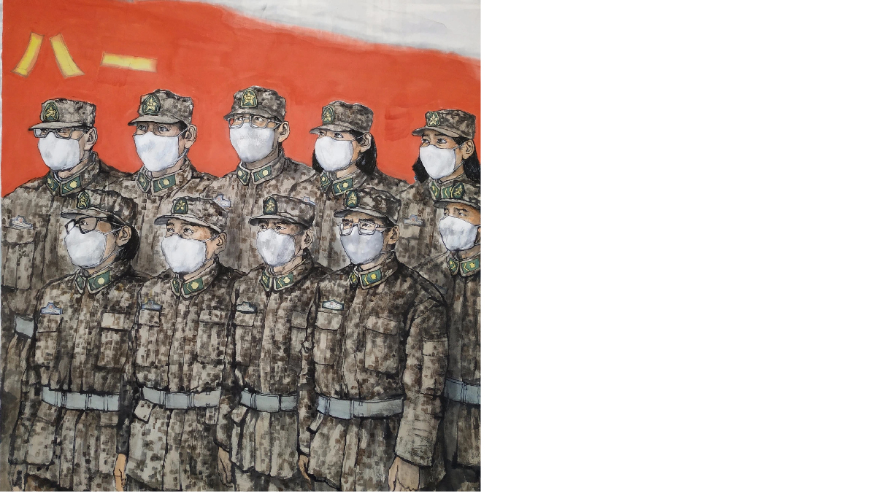
Solid Backing -- Cui Aiguo

Slide 31
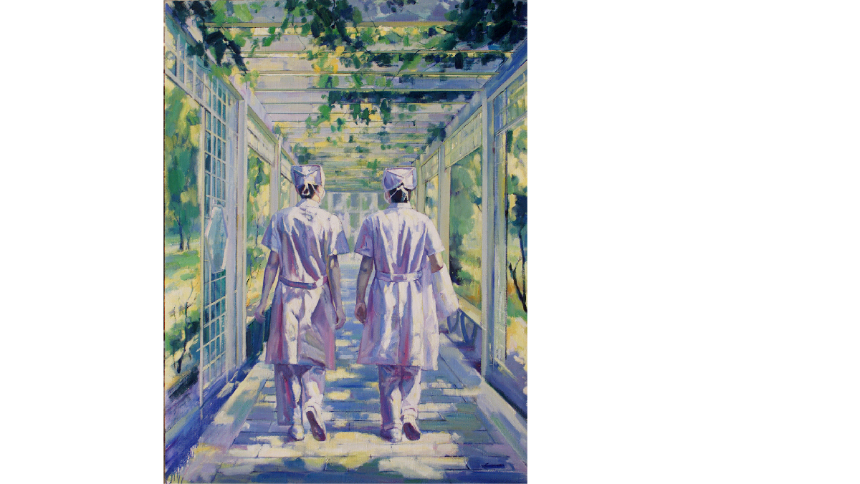
Sunshine Always Comes After Storms -- Zhou Wufa

